Slide 1
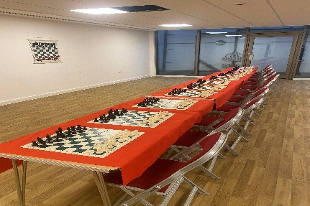
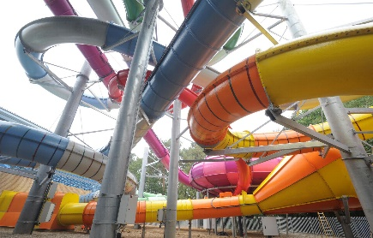
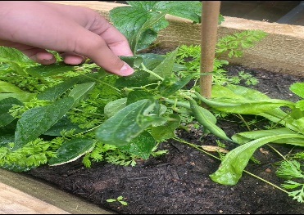
North Paddington Youth Club
October Half Term Programme 2023
JUNIOR CLUB
All Onsite Sessions & Trips are FREE
For ages 8 – 12 years
Please contact Ronnie
for further details on :
020 3875 0412 or email at
clubmanager@northpaddyouth.com
SENSORY ROOM AVAILABLE
FREE Food / Snacks / Refreshments
will be provided each day
Saturday 21st October | Thursday 26th October | Saturday 28th October | Sunday 29th October
VISIT
to
THE NATURAL
HISTORY MUSEUM
Leaving the Club at 12.00
Returning approx. 5pm
------------------------
NPYC JUNIOR CLUB
6.15pm – 8.45pm
Cricket
with MCC Lords
K1 Kick Boxing
Arts & Crafts
Football Session
NPYC JUNIOR CLUB
2:15pm – 4:45pm
Multi Sports
PS4/5
Arts & Crafts
Pool
Table Tennis
Chess Club
Taekwondo
CORAL REEF WATER WORLD
INDOOR WATER PARK
Leaving Club at 10am
Returning approx. 4pm
You MUST be able to swim
at least 25 metres unaided
NPYC JUNIOR CLUB
2:15pm – 4:45pm
Multi Sports
AED Defibrillator Training
PS4/5
Arts & Crafts
Taekwondo
Ready Steady Cook
Chess Club

Slide 2
North Paddington Youth Club
October Half Term Programme 2023
All Onsite Sessions & Trips are FREE
For ages 8 – 12 years
JUNIOR CLUB
AED DEFIBRILATOR AVAILABLE IN RECEPTION
Please contact Ronnie
for further details on :
020 3875 0412 or email at
clubmanager@northpaddyouth.com
SENSORY ROOM AVAILABLE
FREE Food / Snacks / Refreshments
will be provided each day
Consent forms will be available one week before the trips are due. Booking is required. You can do this by seeing a member of staff at the Youth Club or sending an email to clubmanager@northpaddyouth.com
There is no need to book a place for any of our onsite sessions. Just turn up and complete a Membership Form to become a member.
Its FREE to join!!
As we will be arriving back home from some of the trips late at night and for safety reasons, we will be providing a drop off service in our Minibus to your home address. This service is for Westminster members and local surrounding boroughs only
If you need any additional support in travelling to and from any of our sessions or cannot travel independently, please see a member of staff for further details on how we can support you.
North Paddington Youth Club is an inclusive Club, so all children and young people are more than welcome to participate in any of our sessions. If you require additional support to make this happen, please see a member of staff.
FREE FOOD SHOPPING ON WEDNESDAY 25th OCTOBER WILL BE AVAILABLE FOR FAMILIES TO TAKE HOME FROM 4pm – 6pm

