Slide 1
Churchill Gardens Youth Hub
Where - Churchill Hall, Pimlico, London SW1V 3JA
When – 23rd – 27th October 2033
What – Half Term Programme
Why – FOR ALL TO ENJOY
CONTACT INFORMATION
Champagne Wint
Email - c.wint@futuremen.org
Phone – 07467104500
Zahide Sidiammi
Email – z.sidiammi@futuremen.org
Phone – 07810789292

Slide 2
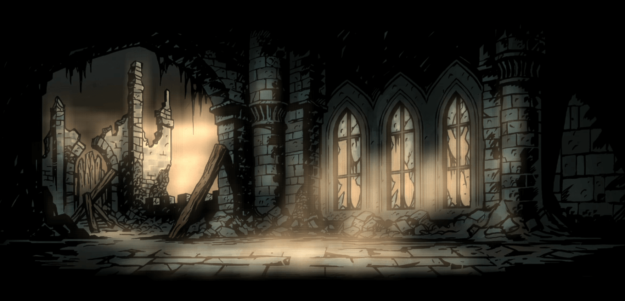
Monday 23rd
Tuesday 24th
Wednesday 25th
Thursday 26th
Friday 27th
12:00- 18:00 Cooking (CW) 12:00-14:00 Pool Table Tennis Table Football Board Games
12:00- 18:00 Games session 12:30-13:30 IGXU 14:00-16:00 Pool Table Tennis Table Football
12:00- 18:00 Community Walk 14:00-14:45 VR 15:00-18:00
12:00- 18:00 LONDON DUNGEON 13:00-17:00
12:00- 18:00 Thorpe park 13:00-20:00 Limited spaces left

