Slide 1
AMBERLEY YOUTH HUB Autumn Timetable 2023
Millennium Centre, 11 Clearwell drive, Amberley rd w9 2jz
Contact: Champagne
07467 104 500
c.wint@futuremen.org

Slide 2
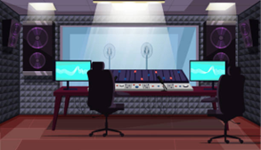
Week 5 | 09/10/2023 | 10/10/2023 | 11/10/2023 | 12/10/2023 | 13/10/2023
 | Closed | Cooking Arts & Crafts Music Studio Gym | Partisan 2 – 4pm Creative writing Workshop- county lines Music studio | Boxing 5 – 7pm Do the Mic Thing music therapy 5 – 7pm | Workshop Black History Project
Week 6 | 16/10/2023 | 17/10/2023 | 18/10/2023 | 19/10/2023 | 20/10/2023
 | Closed | Cooking Arts & Crafts Music Studio Gym | Partisan 2 – 4pm Creative writing Workshop Music studio | Boxing 5 – 7pm Do the Mic Thing 5 – 7pm | Workshop Black History Project

Slide 3
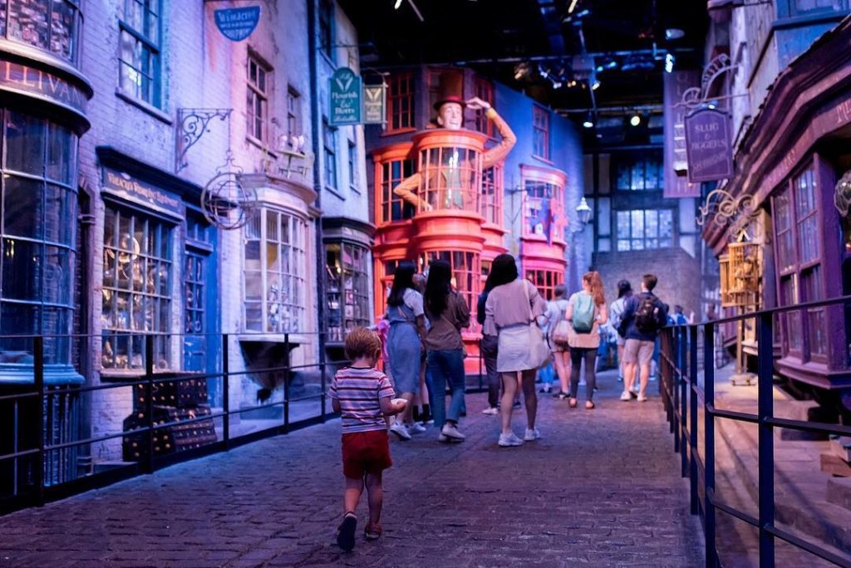
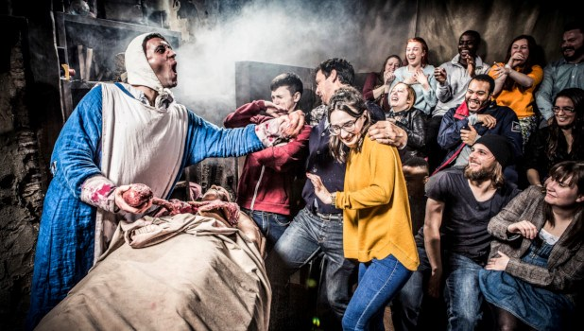
HALF TERM | Monday 23/10/2023 | Tuesday 24/10/2023 1 – 7pm | Wednesday 25/10/2023 12 – 6pm | Thursday 26/10/2023 12 -6pm | Friday 27/10/2023 12-9pm
 | Closed | IGXU Workshop Keeping yourself safe 2-3pm Black History 4-5pm Cooking Arts & Crafts Knife Crime Workshop 5-6pm | London Dungeon | VR escape room | Fright Night Thorpe Park 12-9pm Limited spaces left

